Slide 1

Domain: MATLAB
Technology: COMMUNICATION
A Hybrid Fault-Tolerant Routing based on Gaussian
Network for Wireless Sensor Network

Slide 2
Index
Abstract
Introduction
Literature review
Existing Method
Disadvantages
Proposed method
Advantages
Applications
Results
Conclusion
Hardware and Software Requirements
References

Slide 3
Abstract
Clustering of sensor nodes in a Wireless Sensor Network (WSN) is a difficult task there exists a number of methods or techniques for clustering without energy overhead and unbalanced energy distribution, but none of them are so effective at clustering. So, we are implementing a new Clustering Routing Algorithm Based on Hybrid approach for Fault Tolerant which is so better at clustering of sensor nodes without a considerable energy overhead. Rather clustering through depending on the energy of nodes, Hybrid routing approach establishes the Gaussian Network and Thereby, decreasing energy dissipation at a very considerable value.
Keywords – Hybrid Fault Tolerant Routing, Wireless Sensor Nodes (WSN), Clustering, Routing.

Slide 4
Introduction:
Wireless Sensor Network (WSN) is a network of a number of sensors that senses the data from the surroundings, which are further processed and produces output through various processes. Each sensor in the network is a node. Every time a node collects its data and it should be transferred to the Base Station (BS). For transferring packets of data to the BS, the nodes have to aggregate the data bits that are collected into packets. Each time the nodes aggregating the data bits and sending to the BS by itself consumes more energy, so, the nodes a clustering method was proposed for making those all processes by a single node which is CH of that particular cluster. Through this way, all nodes need not to use their energy to collect data, process it, aggregating it and sending to the BS every time, a particular node will be elected as a CH for a cluster and it will collect the data, process it, makes the data bits into packets and sends it to the BS at a regular intervals making other nodes energy consumption low when and increasing their lifetime for a considerable time. There exists many clustering techniques, one of them are, Hybrid Fault Tolerant, it clusters better than any of the currently existing techniques.

Slide 5
Literature review:
S. NO | Journal Type with year | Authors | Title | Outcomes
1 | IEEE Trans. Consum. Electron. 66 (2020) 223. | P. Chanak and I. Banerjee | “Congestion Free Routing Mechanism for IoT-Enabled Wireless Sensor Networks for Smart Healthcare Applications ” | Studied about routing mechanism for making congestion free in IoT
2 | IEEE Access 9 (2021) 65660 | M. N. M. Bhutta and M. Ahmad | “Secure Identification, Traceability and Real-Time Tracking of Agricultural Food Supply During Transportation Using Internet of Things” | Studied about identification, traceable and tracking of things using IoT
3 | IEEE Internet Things J. 6 (2018) 3024. | J. B. Valencia, L. C. Londono, D. M. Viloria, and M. R. Garcia: | “Lightweight Dynamic Auto-Reconfigurable Protocol in an IoT-Enabled WSN for Wide-Area Remote Monitoring” | Studied about LDAP in with WSN for WARM
4 | IEEE Trans. Smart Grid 10(2019)4323 | S. A. Alavi, K. Mehran, Y. Hao, A. Rahimian, H. Mirsaeedi, and V. Vahidinasab | “A Distributed Event-Triggered Control Strategy for DC Microgrids Based on Publish-Subscribe Model Over Industrial Wireless Sensor Networks” | A networker is employed for observing network traffic was studied
5 | IEEE Trans. Wireless Commun. 19 (2020) 696. | Q. Li, N. Zhang, M. Cheffena, and X. Shen | “Wireless communication Basics” | Contains every thing related to wireless communications

Slide 6
Existing method:
Low Energy Adaptive Clustering Hierarchy (LEACH) Protocol is a founding or one of the earliest techniques for clustering of sensor nodes. LEACH protocol uses the energy values of the nodes and their random numbers which is a value between 0 and 1. Later, a threshold value will be calculated based on the probabilities of a node becoming a CH and their random numbers, then, those nodes which have energies higher than the threshold will be selected as CHs and each CH display it through a message of becoming a CH. Remaining nodes will join the nearest CH and forms clusters. Every time the nodes sends its data to the CH in their time slots, CH will transmits it as a packets to the BS. After, the CH reaching below the threshold value it will become a node again and the node which has next highest energy than the threshold value will becomes CH.

Slide 7
Disadvantages in Existing methods:
If any CH will be dead then, the packets from that particular cluster will never reaches the BS resulting in loss of data of that cluster.
There exists an unbalanced energy consumption when the rounds goes on.
There is no optimal limit for the number of nodes in a cluster.

Slide 8
Proposed method:
There exists a number of techniques for clustering of nodes in a WSN, but none of them considers faults while clustering. Even though clustering is better in some of the approaches, none of the clustering algorithms doesn’t considers Faults in a Wireless Sensor Network. For that, we are implementing, the Hybrid Approach for Fault Tolerant Routing Algorithm. The approach constructs a Gaussian Network, for an efficient way to detect the faults in a WSN. Gaussian Network is a network of nodes that have become Cluster Heads (CHs), for that particular round. All the CHs of all clusters are connected through forming a Gaussian Network. The Gaussian Network reveals the behavior of the clusters, so, whenever a cluster undergoes a fault it can be detected easily and the data transmission of that particular cluster won’t be stopped, in fact, it will be shared by the remaining nodes of the Gaussian Network to be sent to the BS.

Slide 9
Advantages of Proposed method:
1. All the CHs are connected through Gaussian Network making chance of faults occurring less.
2. CHs nodes are connected through GN, making the chances of fault tolerance high.
3. Fault tolerance is higher compared to remaining algorithms.

Slide 10
Applications:
1. IOT environment
2. Satellite communication
3. Weather and temperature forecasting

Slide 11
Hardware and Software Requirements:
Hardware & Software Requirements:
Software: Matlab R2018a.
Hardware:
Operating Systems:
• Windows 10
• Windows 7 Service Pack 1
• Windows Server 2019
• Windows Server 2016
Processors:
Minimum: Any Intel or AMD x86-64 processor
Recommended: Any Intel or AMD x86-64 processor with four logical cores and AVX2 instruction set support
Disk:
Minimum: 2.9 GB of HDD space for MATLAB only, 5-8 GB for a typical installation
Recommended: An SSD is recommended a full installation of all Math Works products may take up to 29 GB of disk space
RAM:
Minimum: 4 GB
Recommended: 8 GB

Slide 12
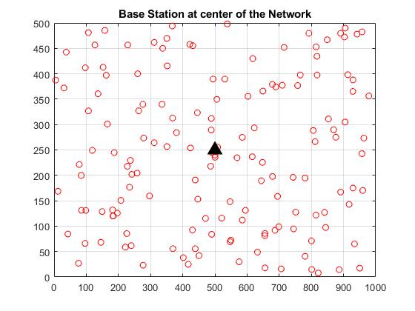
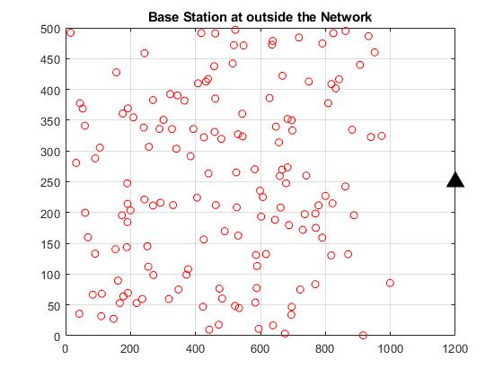
Results :

Slide 13
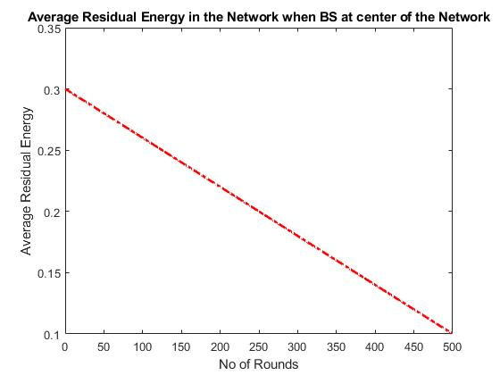
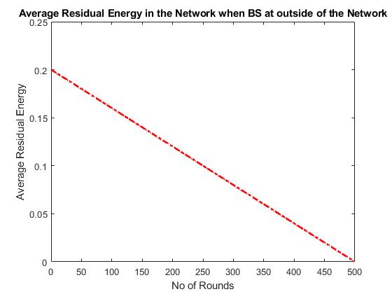

Slide 14
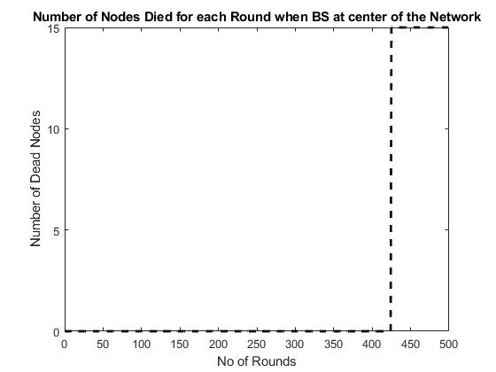
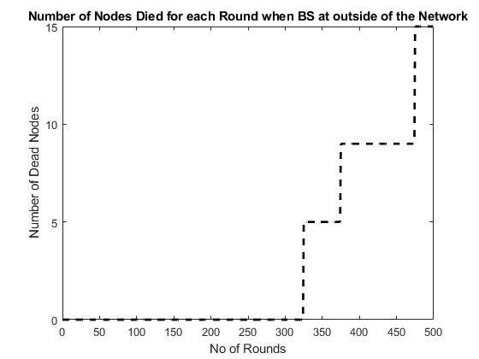

Slide 15
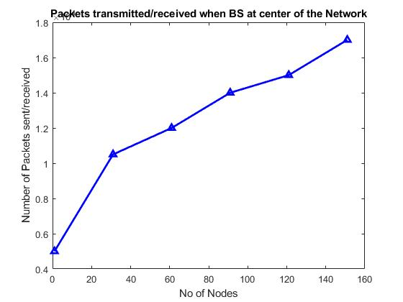
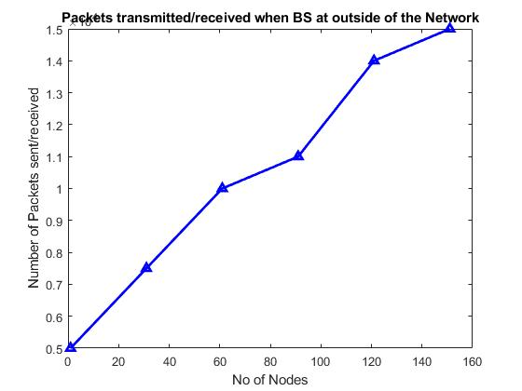

Slide 16
Conclusion:
for wireless sensor network using the Gaussian network connection properties and clustering routing. According to our approach, the sensors are randomly distributed in a rectangular area and clustered into several square grids. The CH nodes are connected together to form a Gaussian network, so this approach has improved fault tolerance through symmetric links and multi-path routing. In addition, the CH nodes are represented as Gaussian integers, which is used in the routing protocol to reduce the complexity of routing algorithms.

Slide 17
References:
1] S. Sharma, K. B. Rakesh, and B. Savina, “Issues and challenges in wireless sensor networks,” in Proc. IEEE ICMIRA, 2013.
[2] Indu and D. Sunita, “Wireless sensor networks: Issues and challenges,” Int. J. Comput. Sci. Mobile Comput., vol. 3, no. 6, pp. 681–685, June 2014.
[3] M. A. Kafi, J. B. Othman, and N. Badache, “A survey on reliability protocols in wireless sensor networks,” ACM Comput. Surveys, vol. 50, no. 2, pp. 31:1–31:47, June 2017.
[4] Mehdi Afsar, “A comprehensive fault tolerant framework for wireless sensor networks,” Security Commun. Netw., vol. 8, no. 17, pp. 3247–3252,Mar. 2015.
[5] K. Gholamreza, G. Savita, and S. Sukhwinder, “A survey on fault tolerance techniques in wireless sensor networks,” in Proc. IEEE ICGCIoT, 2015.

